Slide 1
PERIODONTAL PLASTIC SURGERY-II
RUNGTA COLLEGE OF DENTAL SCIENCES AND RESEARCH
DEPARTMENT OF PERIODONTOLOGY
FINAL YEAR BDS
PRESENTED BY:
Dr. Aena Jain Pundir
Professor
Dept. of Periodontology

Slide 2
Contents
Introduction
Root coverage procedures
Laterally repositioned flap
Free soft tissue graft procedure
Summary
References

Slide 3
Specific Learning Objectives
Core area | Domain | Category
Introduction | Affective | Nice to know
Root coverage procedures | Cognitive | Must know
Laterally repositioned flap | Cognitive | Must know
Free soft tissue graft procedure | Cognitive | Must know

Slide 4
ROOT COVERAGE PROCEDURES
(1) Pedicle soft tissue graft procedures and
e.g. laterally sliding flap
(2) Free soft tissue graft procedures.
e.g. coronally repositioned flap

Slide 5
LATERALLY REPOSITIONED FLAP
Introduced by Grupe &Warren (1956)
This technique, which was called the laterally sliding flap operation, involved the reflection of a full thickness flap in a donor area adjacent to the defect and the subsequent lateral displacement of this flap to cover the exposed root surface.
In order to reduce the risk for recession on the donor tooth, Grupe (1966) suggested that the marginal soft tissue should not be included in the flap.
Staffileno ( 1964) and Pfeifer & Heller (1971) advocated the use of a split thickness flap to minimize the potential risk for development of dehiscence at the donor tooth.

Slide 6
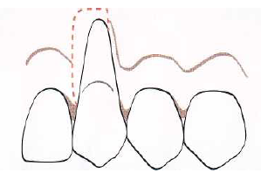
LATERALLY REPOSITIONED FLAP
Introduced by Grupe &Warren (1956)
1. The rotational flap procedure is initiated
with the preparation of the recipient site.
A reverse bevel incision is made all along the soft tissue margin of the defect .
After removal of the dissected pocket epithelium, the exposed root surface is thoroughly curetted.
2. At a distance of approximately 3 mm from the wound edge which delineates the defect at the side opposite the donor area, a superficial incision is made extending from the gingival margin to a level approximately 3 mm apical to the defect

Slide 7
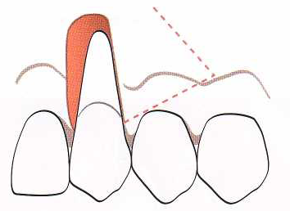
In this way a 3-mmwide recipient bed is created at the one side of the defect, as well as apically to the defect.
A tissue flap to cover the recession is then dissected in the adjacent donor area.
The preparation of this flap is initiated by a vertical superficial incision placed parallel to the wound edge of the recession and at a distance which exceeds the width of the recipient bed and the exposed root surface of approximately 3 mm.

Slide 8
This incision is extended beyond the apical level of the recipient bed and is terminated within the lining mucosa with an oblique releasing incision directed towards the recession site.

Slide 9
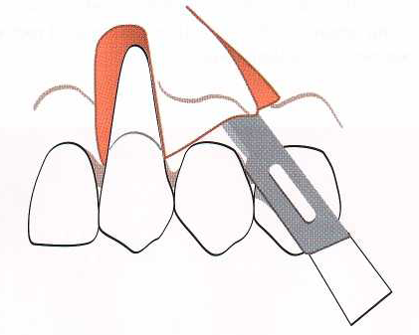
A split thickness flap is then prepared by sharp dissection within the area delineated by these incisions so that a layer of connective tissue is left covering the bone in the donor area when the flap is laterally displaced over the denuded root surface.

Slide 10
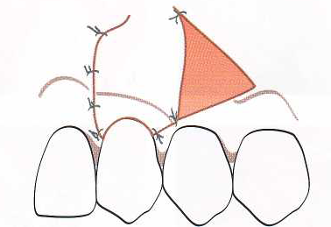
The suturing of the flap should secure a close adaptation of the pedicle graft to the underlying recipient bed.
Pressure is applied against the flap for 2-3 min in order to further secure a good adaptation.
To protect the surgical area during the initial phase of healing, a periodontal dressing is applied.

Slide 11
FREE SOFT TISSUE GRAFT PROCEDURES
A free soft tissue graft of masticatory mucosa is usually selected when there is no acceptable donor tissue present in the area adjacent to the recession defect or when a thicker marginal tissue is desirable.
The procedure can be used for the treatment of a single tooth as well as for groups of teeth.
The graft used may either be
(1) an epithelialized graft or
(2) a subepithelial connective tissue graft of palatal masticatory mucosa.

Slide 12
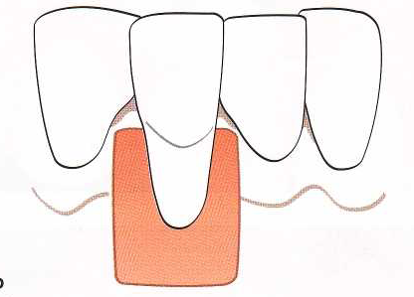
EPITHELIALIZED SOFT TISSUE GRAFT (FREE GINGIVAL GRAFT)
The preparation of the recipient bed is crucial for the success of free graft procedure.
A 3-4-mm-wide recipient connective tissue bed apical as well as lateral of the recession defect should be prepared.
The area is demarcated by first placing a horizontal incision, at the level of the cemento-enamel junction, in the interdental tissue on each side of the tooth to be treated.

Slide 13
Subsequently, two vertical incisions, extending from the incision line placed in the interdental tissue to a level approximately 4-5 mm apical of the recession, are placed.
A horizontal incision is then made, connecting the two vertical incisions at their apical termination.
Starting from an intracrevicular incision, a split incision is made to sharply dissect the epithelium and the outer portion of the connective tissue within the demarcated area.

Slide 14
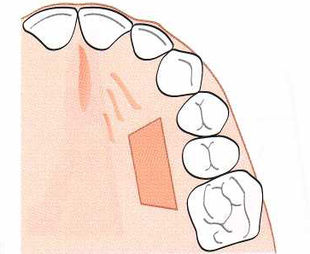
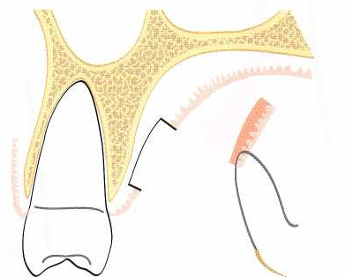
To ensure that a graft of sufficient size and proper contour is removed from the donor area, a foil template of the recipient site is prepared.
This template is transferred to the donor site, the palatal mucosa
in the region of the premolars, and the required size of the graft is outlined by a shallow incision.

Slide 15
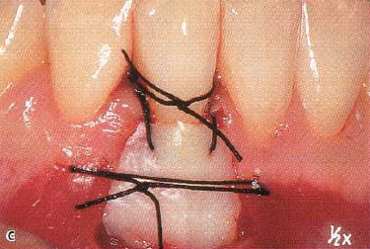
A graft with a thickness of 2-3 mm is then dissected from the donor area.
The graft is immediately placed on the prepared recipient bed.
In order to immobilize the graft at the recipient site, the sutures must be anchored in the periosteum or in the adjacent attached gingiva.
Adequate numbers of sutures are placed to secure a close adaptation of the graft to the underlying connective tissue bed and root surface.

Slide 16
Before the placement of a periodontal dressing, pressure is exerted against the graft for some minutes in order to eliminate blood between the graft and the recipient bed.
The wound in the donor area in the palate is, following the control of the bleeding, covered by a periodontal dressing. To maintain the dressing in place during the healing phase, the use of an acrylic plate may often be required.
The sutures and periodontal dressing are usually maintained for 2 weeks.

Slide 17
SUBEPITHELIAL CONNECTIVE TISSUE GRAFT
The technique utilizing a subepithelial soft tissue graft, i.e. the connective tissue, involves the placement of the graft directly over the exposed root and the mobilization of a mucosal flap to be coronally moved for coverage of the graft(Langer & Langer 1985).
The subepithelial connective graft is harvested from the palate or the retromolar pad by the use of a "trap door" approach.

Slide 18
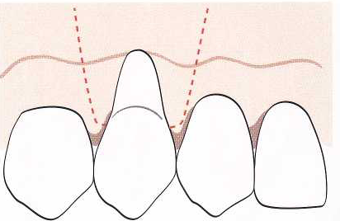
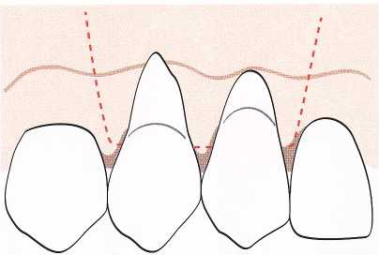
CONNECTIVE TISSUE GRAFT COVERED BY A CORONALLY ADVANCED FLAP
A horizontal incision is first made in the facial surface of the interdental tissue on each side of the teeth to be treated.
The incision should be placed just coronal to the intended level of root

Slide 19
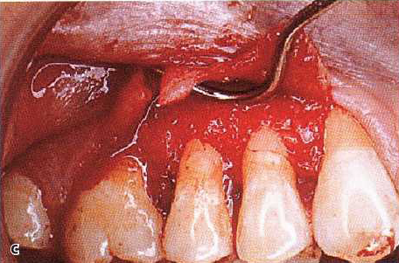
Care should be taken not to decrease the height of the papillae.
Subsequently, starting from the line of incision in the interdental area at the mesial and distal termination of the surgical area, two divergent, vertical incisions are placed and extended well beyond the mucogingival line.
A split thickness flap is then prepared by sharp dissection and elevated to such an extent that it can be coronally repositioned at the level of the cemento-enamel junction without tension.

Slide 20
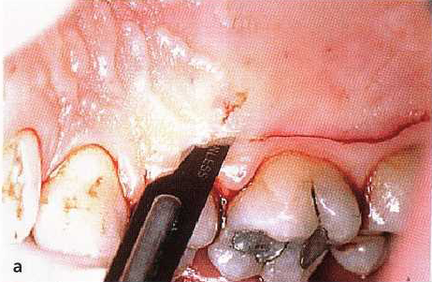
A subepithelial connective tissue graft of masticatory mucosa is harvested on the palatal aspect of the maxillary premolars (or from the retromolar pad) by the use of a "TRAP DOOR" APPROACH.
A horizontal incision, perpendicular to the underlying bone surface, is made approximately 3 mm apical to the soft tissue margin.

Slide 21
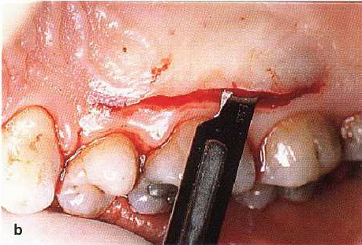
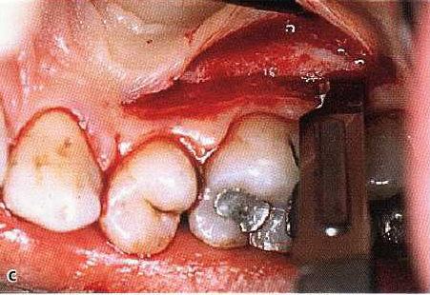
The mesiodistal extension of the incision is determined by the graft size required.
To facilitate the removal of the graft, a vertical releasing incision can be made at the mesial termination of the primary incision.
An incision is then placed from the line of the first incision and directed apically to perform a split incision of the palatal mucosa

Slide 22
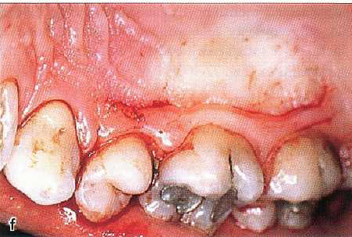
A small periosteal elevator or the scalpel is used to release the connective tissue graft from the bone.
Sutures may be placed in the graft before it is released completely free from the donor area to facilitate its placement at the recipient site.

Slide 23
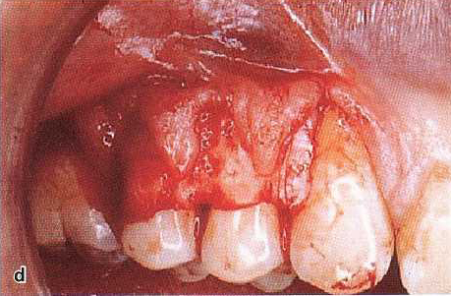
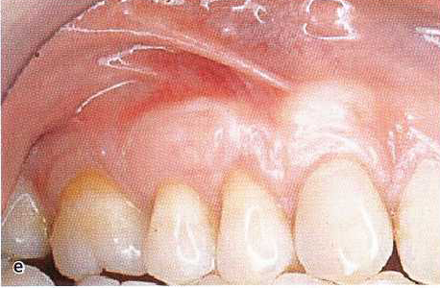
The graft is immediately placed in the recipient site and secured in position with interrupted sutures or a sling suture.
The mucosal flap is then sutured to cover the connective tissue graft.
Interrupted sutures are placed in the papilla regions as well as along the wound of the vertical incisions.
A surgical dressing may be applied for protection of the area during the first week of healing.

Slide 24
ADVANTAGES OF CT OVER FGG
Less invasive palatal wound
Improved esthetic result
Better color match
It carries the genetic message for the overlying epithelium to be keratinized.

Slide 25
Summary
Lack of keratinized gingiva, gingival recession, aberrant frenum and esthetic deformities of gingiva constitute mucogingival problems. There is no prescribed minimum width of attached gingiva. A wider zone of attached gingiva is desirable before orthodontic treatment, and in teeth that serve as abutments as well as in ridge areas bearing an implant or a denture. Free gingival autograft is a more common procedure to augment the width of attached gingiva. Apically displaced flaps not only eliminate the pockets but also aid in increasing the width of attached gingiva. The subepithelial connective tissue graft and coronally advanced flap procedures are the most predictable techniques for root coverage. Pouch and tunnel technique, VISTA, pin hole approach, use of allogenic grafts are the techniques used for multiple root coverage.

Slide 26
References
Newman MG, Takei HH, Klokkevold PR, Carranza FA. Carranza’s clinical periodontology, 10th ed. Saunders Elsevier; 2007.
Lindhe J, Lang NP and Karring T. Clinical Periodontology and Implant Dentistry. 6th ed. Oxford (UK): Blackwell Publishing Ltd.; 2015.

